Slide 1
Module 2
Symmetric and Asymmetric Key Cryptography and Key Management

Slide 2
Components of Block Cipher
D-boxes(Diffusion Box)- It is equivalent to transposition cipher
S-boxes(substitution box)- It is equivalent to substitution cipher.

Slide 3
Components of Block Cipher
D-boxes(Diffusion Box)- It is equivalent to transposition cipher
Straight D-box
Compression D-box
Expansion D-box

Slide 4
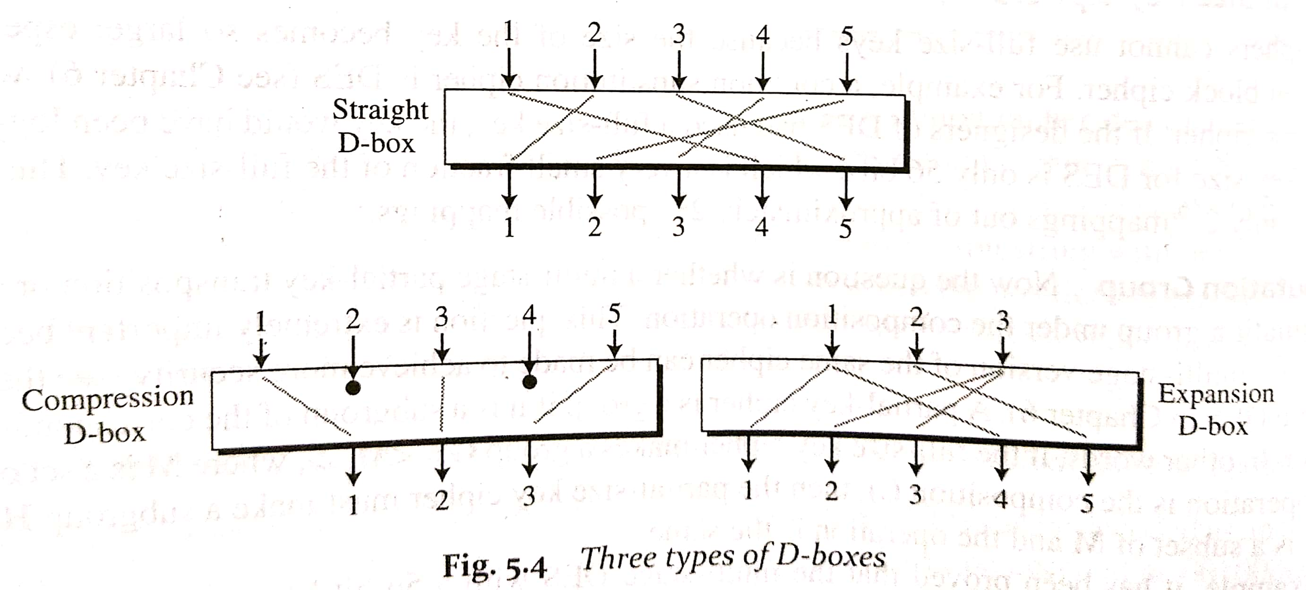
Components of Block Cipher

Slide 5
Components of Block Cipher
D-boxes(Diffusion Box)- It is equivalent to transposition cipher
Straight D-box
Compression D-box
Expansion D-box
S-boxes(substitution box)- It is equivalent to substitution cipher. S-box is a mxn substitution unit where m and n are not necessarily the same.
Linear Vs Non Linear
Exclusive-Or
Circular shift

Slide 6
Components of Block Cipher
Product Ciphers
Diffusion and Confusion
Diffusion hides the relationship between cipher text and plain text
Confusion hides the relationship between cipher text and key
Rounds
Two classes of Product Ciphers:
Fiestal
Non-Fiestal

Slide 7
Components of Block Cipher
Fiestal Ciphers
The purpose is to use the concept of invertiblity (encryption and decryption should be ineverse of each other)
Fiestal cipher consists of three types of components:self invertible, invertible and non invertible
Non invertible components are combined together in a single unit
It is divided into left and right halves, xor is applied, mixer and swapper are used which makes the encryption and decryption inverse of each other.
Example- XOR, Expansion or Compression D boxes
Non-Fiestal Cipher
It uses only invertible components.
No division into left and right halves.
Example-S boxes(equal no. of input and output)

Slide 8
Symmetric and Asymmetric Key Cryptography and Key Management
Block cipher principles
Block cipher modes of operation

Slide 9
Block Cipher Principles

Slide 10
Block Cipher Modes of Operation
Block ciphers encrypt fixed size blocks
eg. DES encrypts 64-bit blocks, with 56-bit key
Partition message into separate block for ciphering
A mode of operation describes the process of encrypting each of these blocks under a single key
Some modes may use randomized addition input value

Slide 11
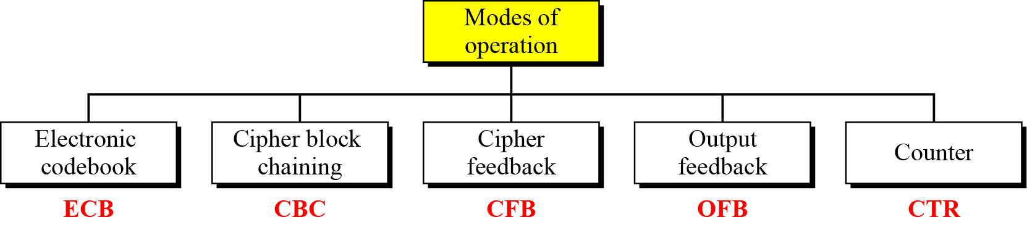
Block Cipher Modes of Operation

Slide 12
Electronic Codebook (ECB)
Message is broken into independent blocks which are encrypted
Each block is a value which is substituted, like a codebook
Each block is encoded independently of the other blocks
C_{i} = E_{K} (P_{i})
Uses: secure transmission of single values

Slide 13
Cipher block chaining(cbc)
Message is broken into independent blocks which are encrypted
Each block is a value which is substituted, like a codebook
Each block is encoded independently of the other blocks
C_{i} = E_{K} (P_{i})
Uses: secure transmission of single values

Slide 14
Important concepts
Initialize Vector (IV)
A block of bits to randomize the encryption and hence to produce distinct ciphertext
Nonce : Number (used) Once
Random of psuedorandom number to ensure that past communications can not be reused in replay attacks
Some also refer to initialize vector as nonce

Slide 15
Important concepts
Padding
final block may require a padding to fit a block size
Method
Add null Bytes
Add 0x80 and many 0x00
Add the n bytes with value n

